Slide 1
Reinforcement Learning in Games
Ege Can Özer
Notes:
RL and DL emerging once again with the recent success in AlphaGo
Today I will talk about some RL algorithms in game context
But just before that lets see why we should study RL in games

Slide 2

Motivation
Less complicated, controlled environment
Clear-cut rules
Concrete evaluation measurements
Win %, kill rate, score, time spent
Easy to realize
At least no need to wait for a fund to buy a robot arm ☺
Provides a common tool
Training and testing (Benchmark)
More focus on the algorithm
Notes:
How presentation will benefit audience: Adult learners are more interested in a subject if they know how or why it is important to them.
Presenter’s level of expertise in the subject: Briefly state your credentials in this area, or explain why participants should listen to you.

Slide 3

Challenges
Implementation POV
Hard to find SDK, let’s create the game from scratch
Abstracting the environment
Low-level, high-level, context-free
Performance measures: No hand labeled ground-truth set
Benchmarking tools, Human players, Evaluate individual decisions
Further challenges
Exploitation vs exploration
Many problems DL perspective
Notes:
Sounds perfect up to now. But they also have some challenges.
How many of you ever wondered about how the AI of some game work in your childhood
Well from the study of RL+DL perspective, possible challenges can be listed as
1-Create the game from scratch vs use existing tools
2-What are the main elements of the game, we will actually take a close look at this in each articles
3-How good our model is
4-Exploitation vs exploration
5-DL POV

Slide 4

Outline
Reinforcement Learning to Play Mario [LYY12]
High-level Reinforcement Learning in Strategy Games [AmS10]
Temporal Difference Learning and TD-Gammon [Tes95]
Playing Atari with Reinforcement Learning [MKS13]
4 articles
Conclusion
Notes:
To be ab

Slide 5
Reinforcement Learning to Play Mario [LYY12]
Aim of this study
Design an agent to play and beat the game Mario
Q-learning is model-free
Algorithm oblivious to transitional probabilities
Performs well under specific constraints
Mario AI Framework
Used to both train and test the system
Fast convergence and decent results
5000 iterations, 90% win probability
Notes:
First article is about some typical RL application by Liao et al. That aims to design ...
Search space is actually huge (we’ll see next) it is hard to compute probs.
Such as memory,space and time constraints, 24 fps. And simply this actually fit their needs
The framework provides many details about the action going on. So it is fairly easy to do low-level abstraction
So even the elementary RL algorithms able to get good results
Lets take a look at briefly how does the algorithm work

Slide 6
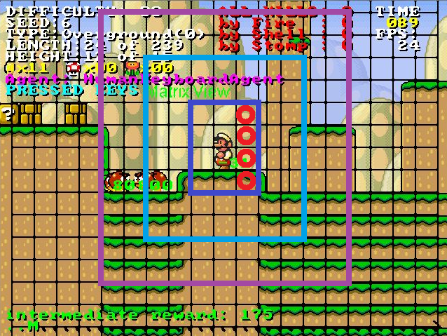

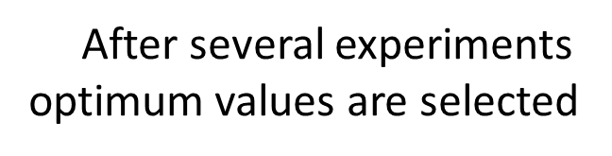
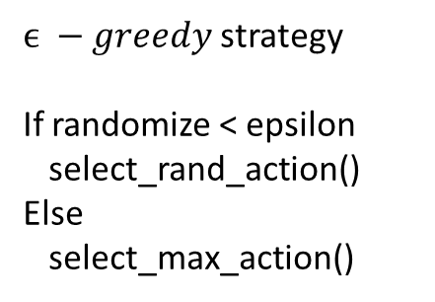

Mario mode: 0 – small, 1 – big, 2-fire
If on ground: 0 or 1
If can jump: 0 or 1
If stuck: 0 or 1
Nearby, midrange, far enemies
If enemies killed by stomp: 0 or 1
...
A state needs 39 bits to encode
Learning rate
$$a\left(s_{t}, a_{t}\right)=\frac{a_{0}}{\# of times a_{t} performed in s_{t}}$$
Q-table
States
How fast learning converges
Positive reward
Moving forward, jump on higher platforms
Reward decreases when there is an enemy nearby
Killing enemies
Negative reward
Colliding with enemies
Being stuck
Initialized with a uniform distribution
Discount factor
Mario performs one of 12 actions
{LEFT, RIGHT, STAY} X
{JUMP, NOT_JUMP} X
{SPEED/FIRE, NOSPEED} X
How much future state is taken into account
Actions
Reward function
$ϵ −greedy$ strategy
If randomize < epsilon
select_rand_action()
Else
select_max_action()
Using Mario AI framework those variables defined
States
Actions
Reward function
Decreasing learning rate
Discount factor
Notes:
How presentation will benefit audience: Adult learners are more interested in a subject if they know how or why it is important to them.
Presenter’s level of expertise in the subject: Briefly state your credentials in this area, or explain why participants should listen to you.

Slide 7
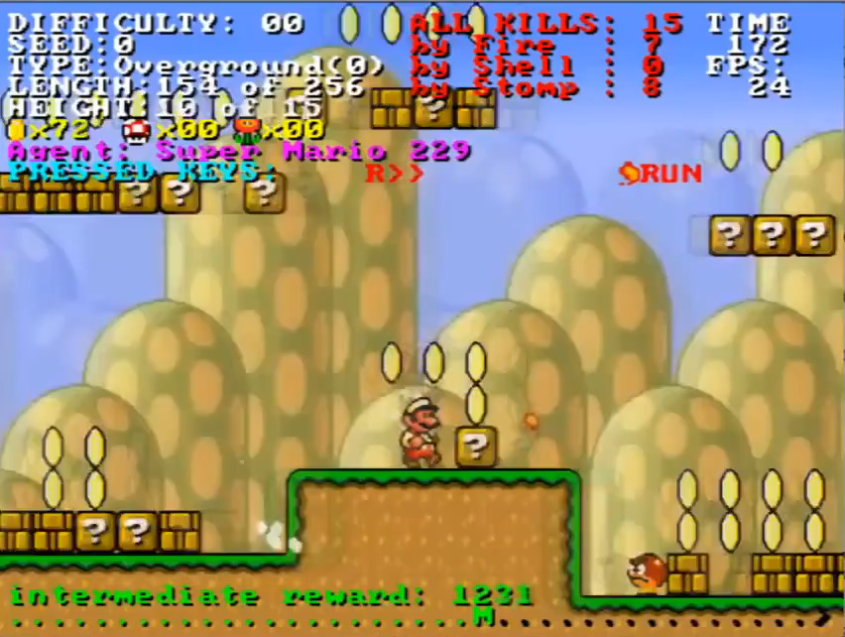
Reinforcement Learning to Play Mario [LYY12]
Four measures
Composite score
Win status
Kills in total
Distance passed
Time spent in frames
Four measures
Composite score
Winning probability
% of Monster killed
Time spent
Notes:
How presentation will benefit audience: Adult learners are more interested in a subject if they know how or why it is important to them.
Presenter’s level of expertise in the subject: Briefly state your credentials in this area, or explain why participants should listen to you.

Slide 8
High-level Reinforcement Learning in Strategy Games [AmS10]
Civilization IV, turn-based strategy games
Many paths to victory
Goal is to improve built-in AI
Switching between high-level strategies
Change leader traits according to situtation
Leave the low-level actions to build-in AI
Create unit, upgrades etc.
They compared 3 algorithms:
Q-learning vs Dyna-Q vs Dyna-Q with factored state representation
Focus only on high-level RL learning and abstraction of the game environment!
Notes:
Amato and Shani introduce an approach to improve the built-in AI by applying RL algorithm
military domination, cultural, diplomatic, technological, time victories.
Expansive, industrious, spiritual etc.
Factored state representation, which is basically same Dyna-q with an assumption of conditionally indepence between state transitions, thus reducing the search space

Slide 9
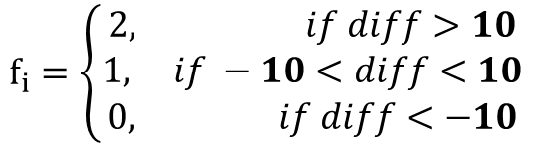
State space
Action space
Reward model
4 state features, in total 81 possible states
Population difference
Land diff.
Military power diff.
Remaining land
Reward based on the score provided by game
Immediate reward, given after each step as
Still possible to lose the game while having high score
What is the Action?
Choice of a new strategy (high-level)
For making low-level decisions
Build, explore, make war etc.
Limited to 4 leaders
Covers all 8 possible leader traits
For example
Washington is Financial and Organized
All common and provided by game
thisStepScore = myTotalScore – yourTotalScore
$f_{i}=\left\{\begin{aligned}2, if diff>10 \\ 1, if −10<diff<10 \\ 0, if diff<−10\end{aligned}\right.$
Notes:
They discretized onto numerical values, The difference is for example, player’s military power – opponent’s military power. Numbes are different for different resource types.
Reward: but the game score is obviously higly correlated with the final outcome of the game

Slide 10
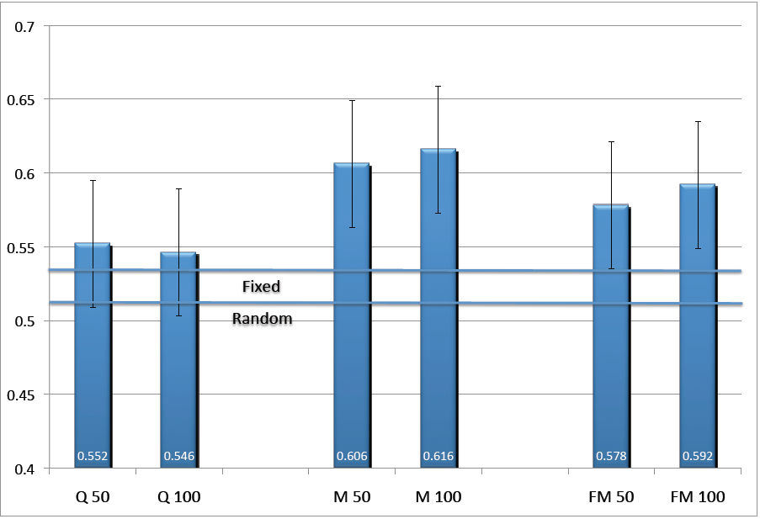
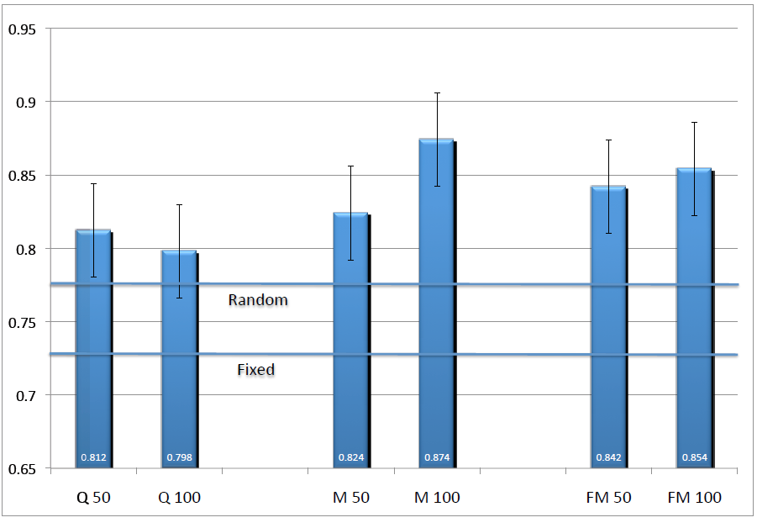
High-level Reinforcement Learning in Strategy Games [AmS10]
versus
versus
Gandhi
Fredrick
Washington
Genghis Khan
Organized
Philosophical
Expansive
Charismatic
Spiritual
Philosophical
Aggressive
Imperialistic
Notes:
I did not include fixed versus random policy strategy selection in here but those lines mean:
Fixed line meaning, percentage of games each leader would win against the chosen opponent
In this case, Fredrick wins against Washington approximately .53 percent
Random policy means, choosing random leader traits at each step

Slide 11
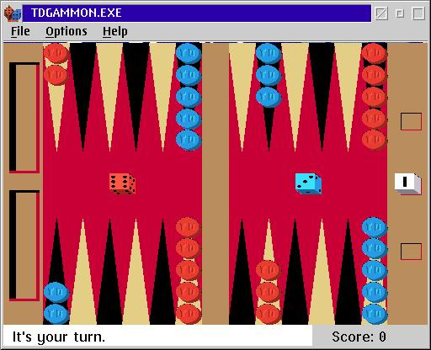
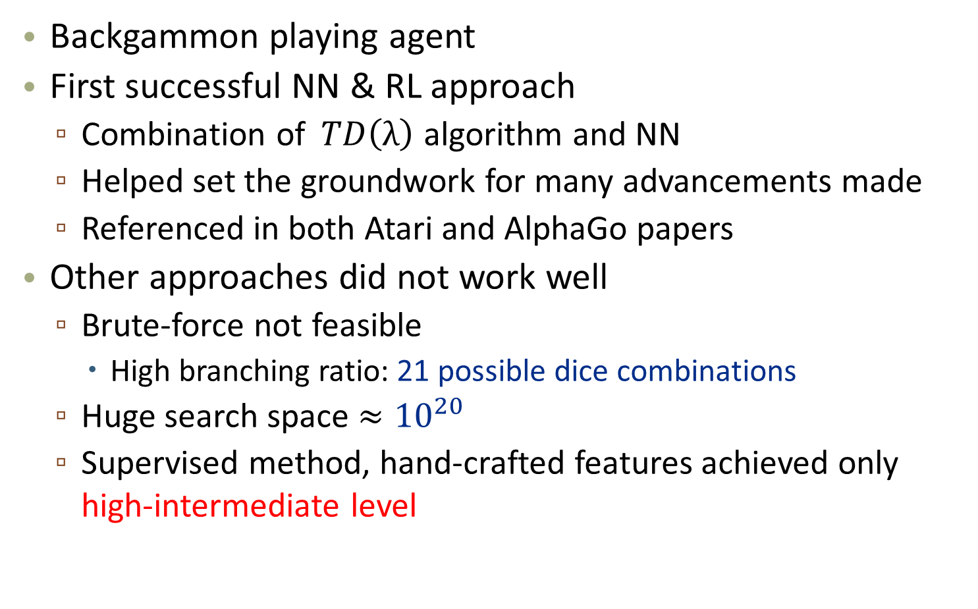
Temporal Difference Learning and TD-Gammon [Tes95]
Backgammon playing agent
First successful NN & RL approach
Combination of$TD\left(λ\right)$ algorithm and NN
Helped set the groundwork for many advancements made
Referenced in both Atari and AlphaGo papers
Other approaches did not work well
Brute-force not feasible
High branching ratio: 21 possible dice combinations
Huge search space $≈{10}^{20}$
Supervised method, hand-crafted features achieved only high-intermediate level
Notes:
Gerald Tesauro published his paper in 1992 describing TD-Gammon as a neural network trained with reinforcement learning. It is referenced in both Atari and AlphaGo research papers and helped set the groundwork for many of the advancements made in the last few years.

Slide 12
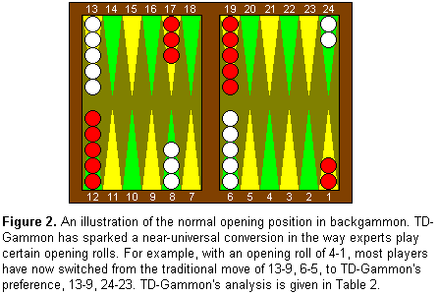
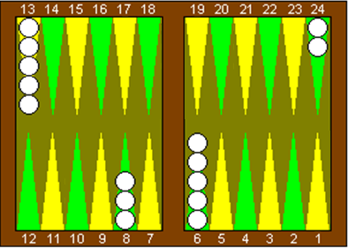
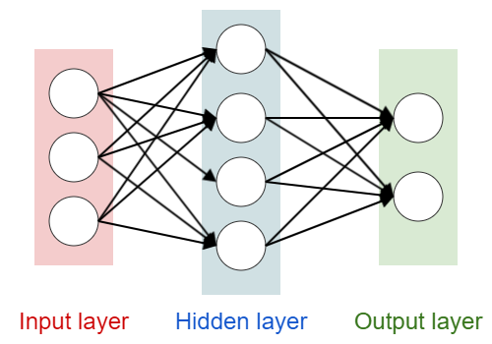
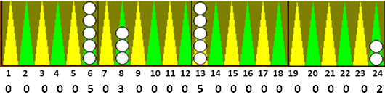
Only one side
Checkers position as feature vectors
White | Normal
Red | Gammon
Notes:
How presentation will benefit audience: Adult learners are more interested in a subject if they know how or why it is important to them.
Presenter’s level of expertise in the subject: Briefly state your credentials in this area, or explain why participants should listen to you.

Slide 13
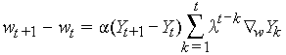
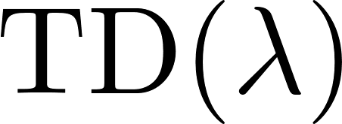
Pr(White wins)
Pr(White gammons)
Pr(Red wins)
Pr(Red gammons)
After each turn, each weight in NN gets updated according to :
First chooses any legal move
After NN weights updated (backpropagation), picks the maximum weighted corresponding move.
Self-training scheme and stochastic environment of the game improves the NN
to change the weight from its
value on the previous turn
The difference between current and
previous turn’s board evaluations
Learning rate
Controls the decay of older estimates.
If => 0
Corrects only the previous turn’s estimate
If => 1
Attempts to correct all previous turns
The gradient of NN output w.r.t to weights
Notes:
is the amount to change, is the difference between, parameter, how much current evaluation should affect previous estimates,

Slide 14
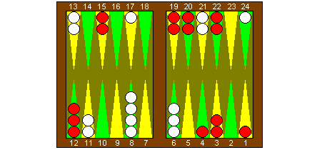
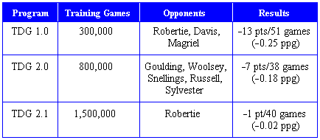
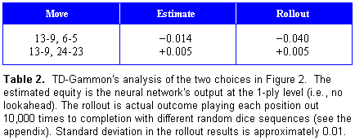
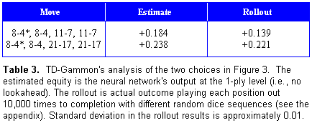
Temporal Difference Learning and TD-Gammon [Tes95]
White is to play 4 - 1
White is to play 4 - 4
Addition!
Later in TDG 3.0 using 160 hidden nodes and a selective 3-ply search,
managed to beat Kazaros +6pts /20 games
Notes:
1.0 : Hidden nodes: 40, 1-ply move selection
2.0 : 40 hn., 2-ply move selection (lookahead)
2.1 : 80 hidden nodes, 2-ply move selection

Slide 15
Playing Atari with Reinforcement Learning [MKS13]
Context-free
Input only from sensory data
Deep Q-network (DQN)
Main goal
Successfully learn to play as much games as possible.
7 Atari games, implemented in the Arcade Learning Environment
Using RL and DL together seems problematic
Highly correlated states vs data samples are independent
Distribution changes vs fixed underliying distribution
Experience replay mechanism
Randomly sample previous transition = smooth the distribution
Notes:
Up to know we saw that game specific information encoded to the algorithm by means of states, action, reward. Mnih et al. Proposes a context-free approach which model takes the information nothing but from images/video input
They achieved this using a method they called DQN. That is a combination of RL and DL.
The main goal is to CREATE AN AGENT THAT IS ABLE TO SUCCESSFULLY ....
In RL data samples are usually consists of highly correlated states, whereas from the DL perspective it is assumed that data samples are independent
Moreover, as the algorithms learn new behaviour its training distribution changes over time, however, in DL methods assume fixed underlying distribution
The article proposes a experience replay mechanism to alleviate aforementioned problems of correlated data and non-stationary distributions, that is, distribution does not change when shifted over time
At each step of training, E.R.M. Randomly sampels previous transitions and thus smooth outs the distribution.

Slide 16
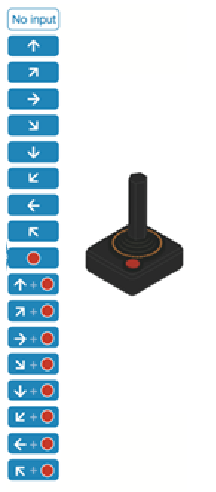
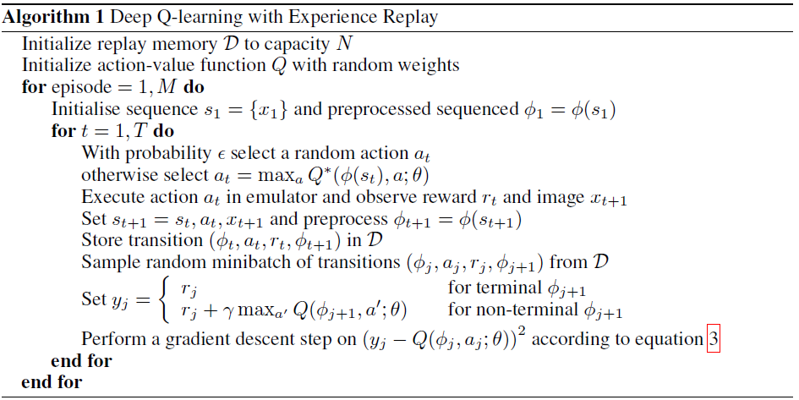
preprocessed
For each replay memory «j»
Game screen
Game
action = move_left
Deep Q Network
For playing
Replay memory
Consequent reward
Consequent state
State
Action
Current state
Replay memory
Smooth training distribution
Preprocessor
Compute Reward
Pick an action
Game
Game screen
Preprocessor
If terminal memory -> current reward
Otherwise; update w.r.t. Max Q value of A
Replay memory
Consequent reward
Consequent state
State
Action
Compute loss
and Update network
Gradient descent
Add to
Action with highest Q-value
Random action
Replay memories
Action
Game
Notes:
How presentation will benefit audience: Adult learners are more interested in a subject if they know how or why it is important to them.
Presenter’s level of expertise in the subject: Briefly state your credentials in this area, or explain why participants should listen to you.

Slide 17
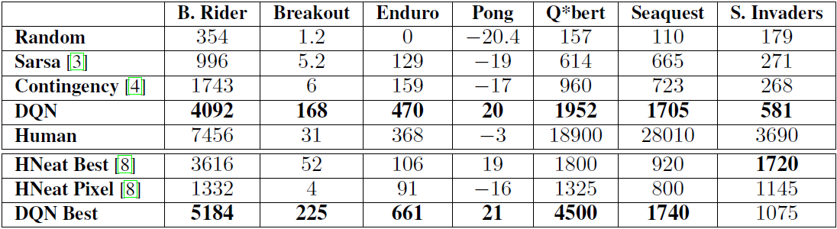
Playing Atari with Reinforcement Learning [MKS13]
Average total reward
Neuro-evolution approach comparison
Notes:
A neuro-evolution approach to general atari game playing.
The HNeat Best score reflects the results obtained by using a hand-engineered object detector algorithm that outputs the locations and types of objects on the Atari screen.

Slide 18
Conclusion
Summary
Some problems in articles
Evaluation
Why did TD-Gammon work? [PoB97]
What to expect next?
Faster, stronger, less HW requirements
Sandbox learning
Notes:
How presentation will benefit audience: Adult learners are more interested in a subject if they know how or why it is important to them.
Presenter’s level of expertise in the subject: Briefly state your credentials in this area, or explain why participants should listen to you.

Slide 19
Thank you for listening!
Questions?
Notes:
How presentation will benefit audience: Adult learners are more interested in a subject if they know how or why it is important to them.
Presenter’s level of expertise in the subject: Briefly state your credentials in this area, or explain why participants should listen to you.

Slide 20
References
[AmS10] Amato, C. and Shani, G., High-level reinforcement learning in strategy games. Proceedings of the 9th International Conference on Autonomous Agents and Multiagent Systems: volume 1-Volume 1. International Foundation for Autonomous Agents and Multiagent Systems, 2010, pages 75-82.
[LYY12] Liao, Y., Yi, K. and Yang, Z., Cs229 nal report reinforcement learning to play mario. Technical Report, Technical report, Stanford University, 2012.
[Tes95] Tesauro, G., Temporal dierence learning and td-gammon. Communications of the ACM, 38,3(1995), pages 58-68.
[MKS13] Mnih, V., Kavukcuoglu, K., Silver, D., Graves, A., Antonoglou, I., Wierstra, D. and Riedmiller, M., Playing atari with deep reinforcement learning. arXiv preprint arXiv:1312.5602
Notes:
How presentation will benefit audience: Adult learners are more interested in a subject if they know how or why it is important to them.
Presenter’s level of expertise in the subject: Briefly state your credentials in this area, or explain why participants should listen to you.

